Slide 1
R 오후과제

Slide 2
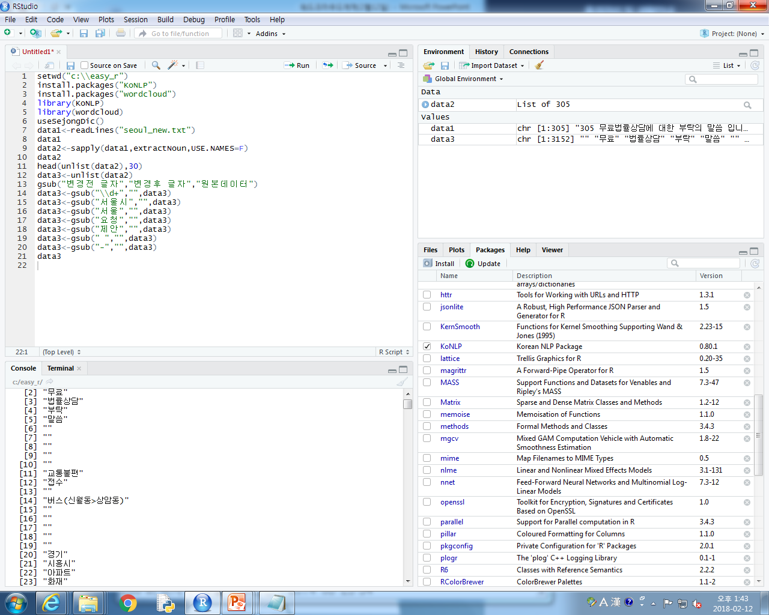
R text UTF-8로 바꾸기
Notes:
setwd("c:\\easy_r")
install.packages("KoNLP")
install.packages("wordcloud")
library(KoNLP)
library(wordcloud)
useSejongDic()
data1<-readLines("seoul_new.txt")
data1
data2<-sapply(data1,extractNoun,USE.NAMES=F)
data2
head(unlist(data2),30)
data3<-unlist(data2)
gsub("변경전 글자","변경후 글자","원본데이터")
data3<-gsub("\\d+","",data3)
data3<-gsub("서울시","",data3)
data3<-gsub("서울","",data3)
data3<-gsub("요청","",data3)
data3<-gsub("제안","",data3)
data3<-gsub(" ","",data3)
data3<-gsub("-","",data3)
data3

Slide 3
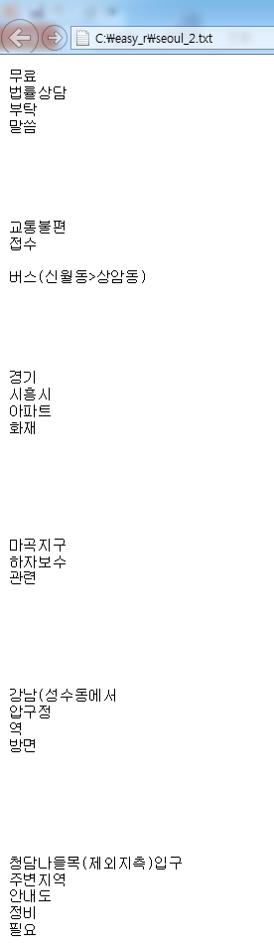
공백제거

Slide 4
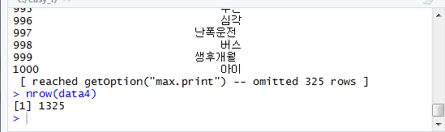
Nrow(data4)-데이터 몇건

Slide 5
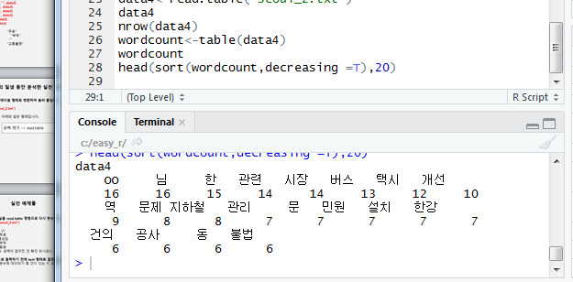

Slide 6
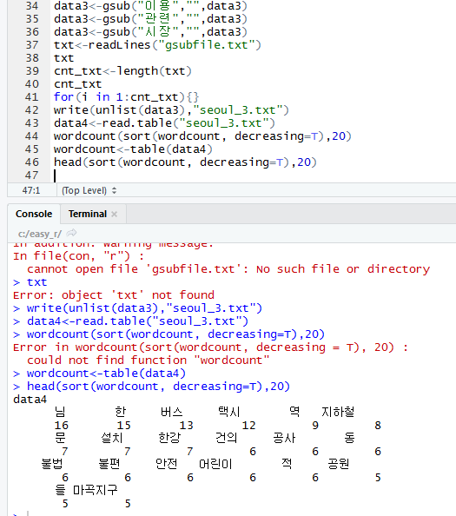

Slide 7
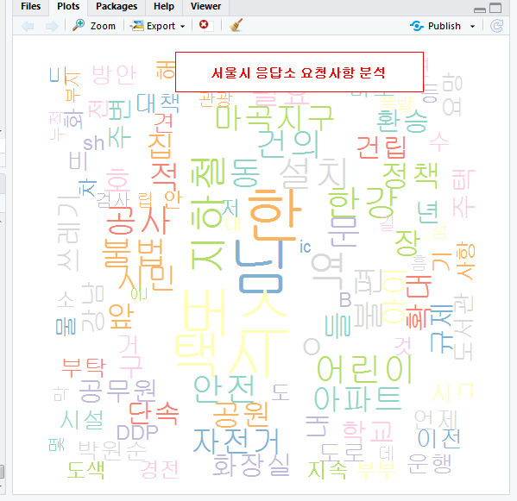
서울시 응답소 요청사항 분석
Notes:
setwd("c:\\easy_r")
install.packages("KoNLP")
install.packages("wordcloud")
library(KoNLP)
library(wordcloud)
useSejongDic()
data1<-readLines("seoul_new.txt")
data1
data2<-sapply(data1,extractNoun,USE.NAMES=F)
data2
head(unlist(data2),30)
data3<-unlist(data2)
gsub("변경전 글자","변경후 글자","원본데이터")
data3<-gsub("\\d+","",data3)
data3<-gsub("서울시","",data3)
data3<-gsub("서울","",data3)
data3<-gsub("요청","",data3)
data3<-gsub("제안","",data3)
data3<-gsub(" ","",data3)
data3<-gsub("-","",data3)
data3
write(unlist(data3),"seoul_2.txt")
data4<-read.table("seoul_2.txt")
data4
nrow(data4)
wordcount<-table(data4)
wordcount
head(sort(wordcount,decreasing =T),20)
data3<-gsub("OO","",data3)
data3<-gsub("개선","",data3)
data3<-gsub("문제","",data3)
data3<-gsub("관리","",data3)
data3<-gsub("민원","",data3)
data3<-gsub("이용","",data3)
data3<-gsub("관련","",data3)
data3<-gsub("시장","",data3)
txt<-readLines("gsubfile.txt")
txt
cnt_txt<-length(txt)
cnt_txt
for(i in 1:cnt_txt){}
write(unlist(data3),"seoul_3.txt")
data4<-read.table("seoul_3.txt")
wordcount(sort(wordcount, decreasing=T),20)
wordcount<-table(data4)
head(sort(wordcount, decreasing=T),20)
library(RColorBrewer)
palete<-brewer.pal(9,"Set3")
wordcloud(names(wordcount),freq=wordcount,scale=c(5,1),rot.per = 0.25,min.freq=1,+random.order = F,random.color=T,colors=palete)
wordcloud(names(wordcount),freq=wordcount,scale=c(5,1),rot.per =0.25,min.freq=1,random.order = F,random.color=T,colors=palete)
legend(0.3,1, "서울시 응답소 요청사항 분석",cex=0.8,fill=NA,border=NA,bg="white",text.col="red",text.font=2,box.col="red")

Slide 8
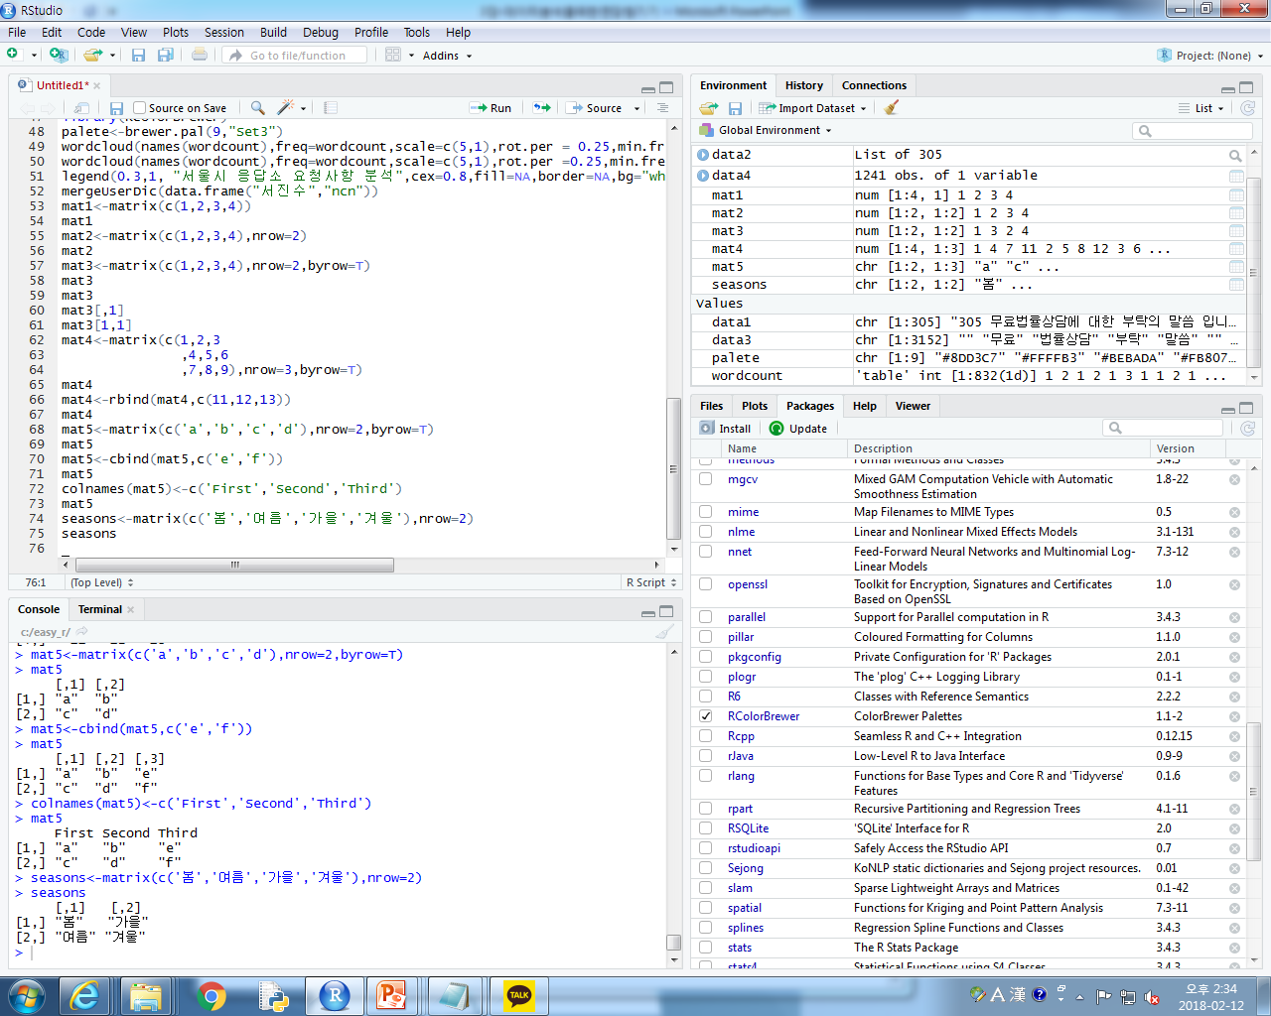
nrow=2, c 추가
Notes:
seasons<-matrix(c('봄','여름','가을','겨울'),nrow=2)
seasons

Slide 9
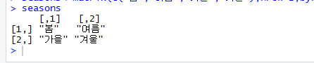
seasons<-matrix(c('봄','여름','가을','겨울'),nrow=2,byrow=T)
seasons

Slide 10
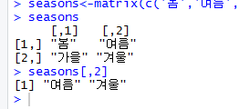
[,2]=세로 [2,]=가로
seasons<-matrix(c('봄','여름','가을','겨울'),nrow=2,byrow=T)
seasons
seasons[,2]

Slide 11
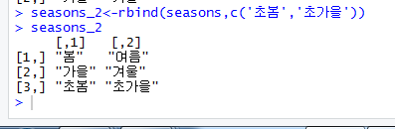
Rbind()=아래추가
seasons<-matrix(c('봄','여름','가을','겨울'),nrow=2,byrow=T)
seasons
seasons[,2]
seasons_2<-rbind(seasons,c('초봄','초가을'))
seasons_2

Slide 12
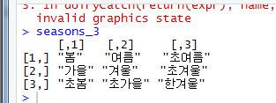
Cbind()=옆에 추가
seasons_2
seasons_3<-cbind(seasons_2,c('초여름','초겨울','한겨울'))
seasons_3

Slide 13
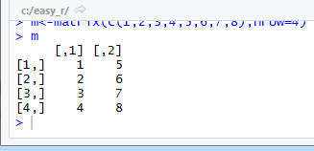
m<-matrix(c(1,2,3,4,5,6,7,8),nrow=4)
m

Slide 14
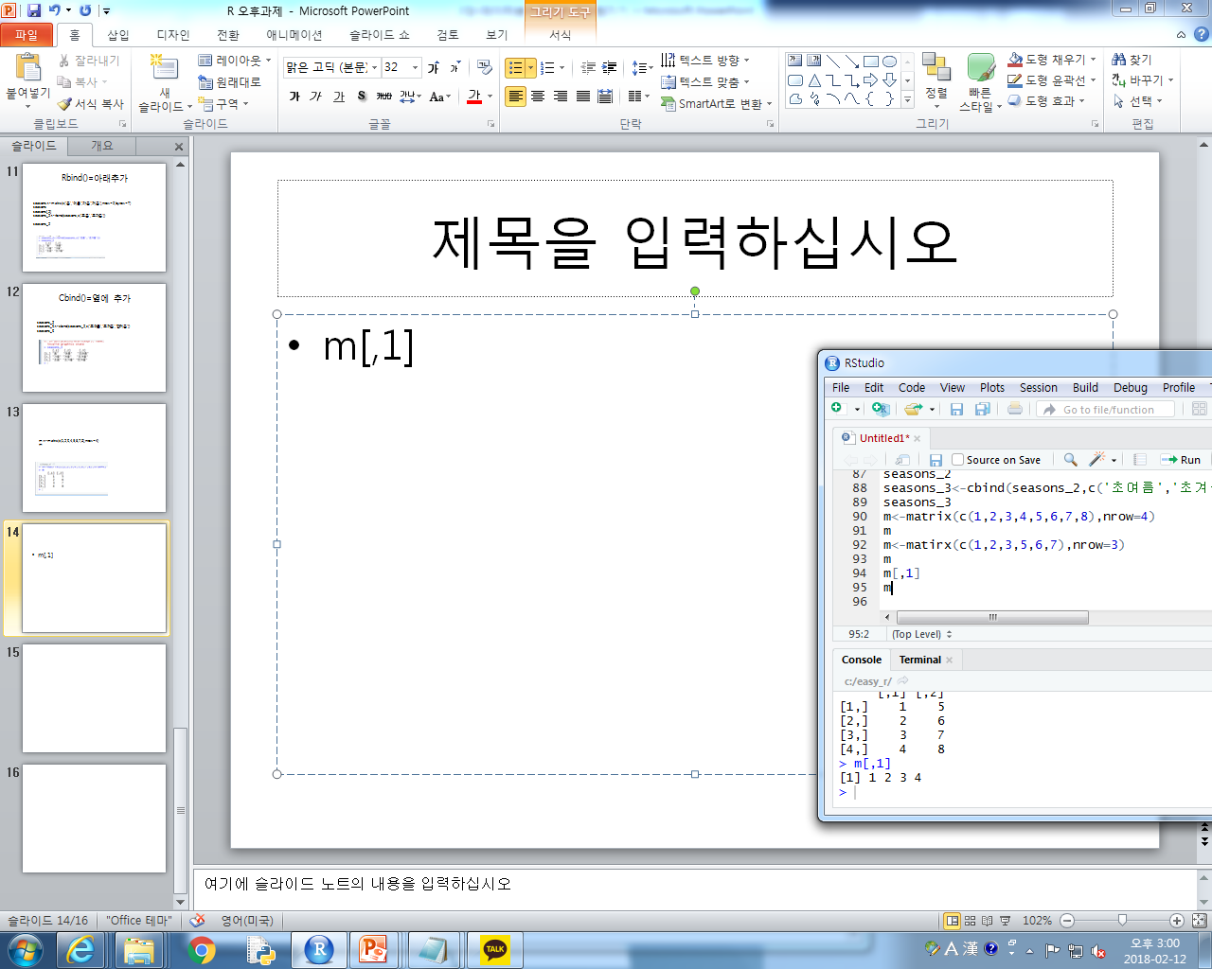
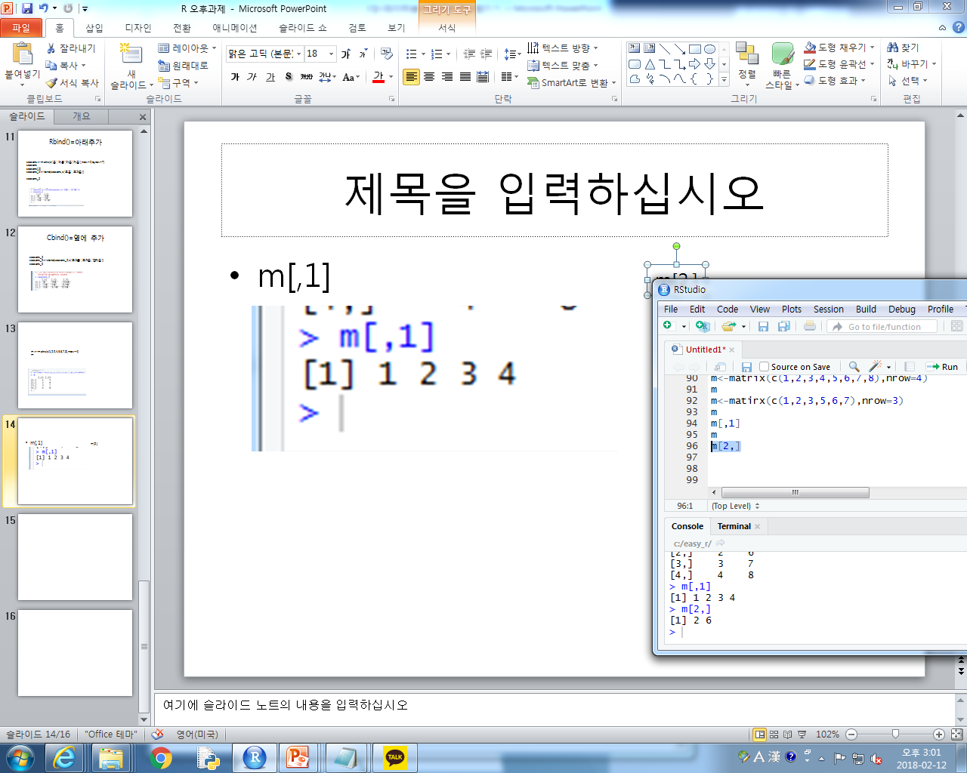
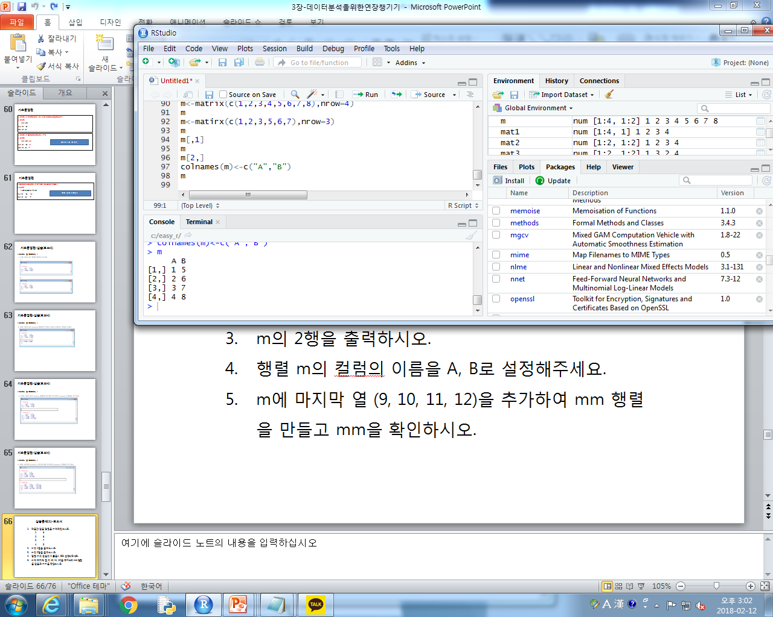
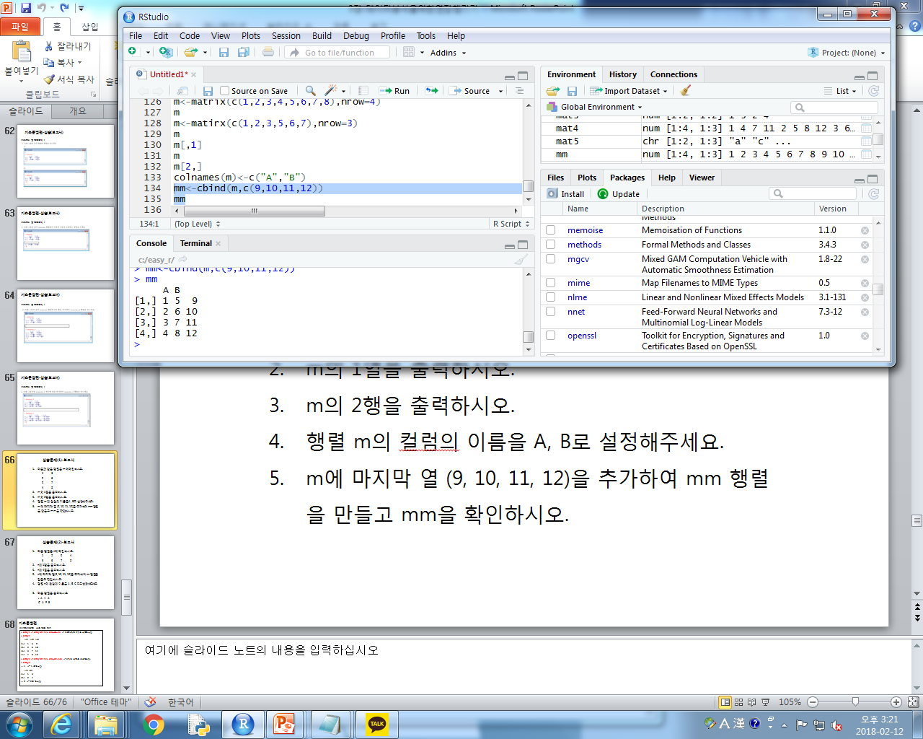
실습문제 1-행렬 m 문제
m[,1]
m[2,]
colnames(m)<-c("A","B")
m
mm<-cbind(m,c(9,10,11,12))
mm

Slide 15
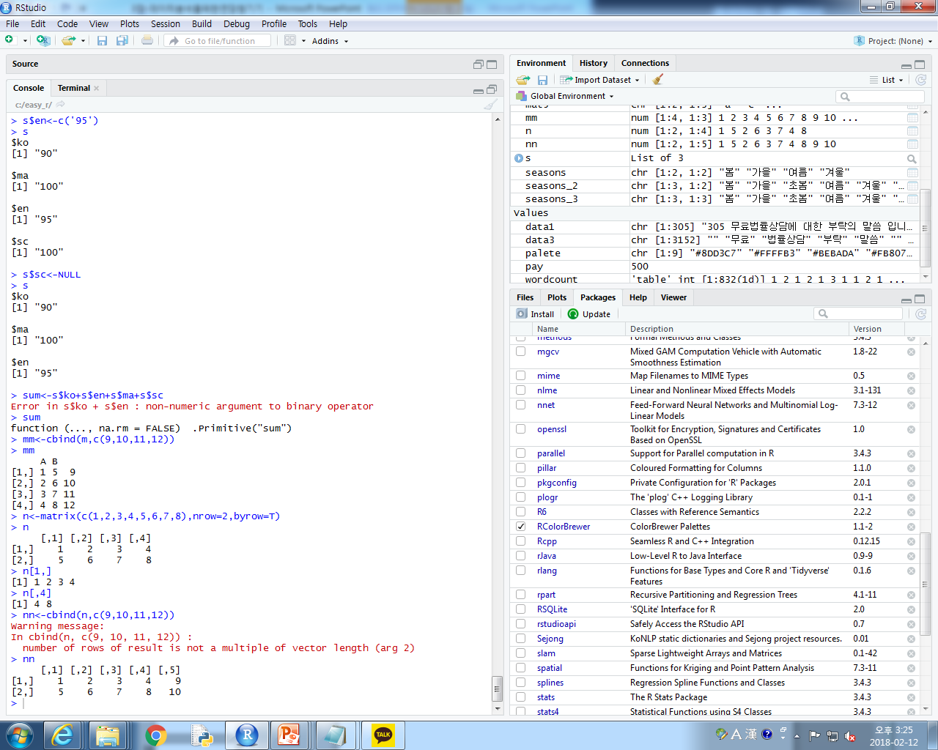
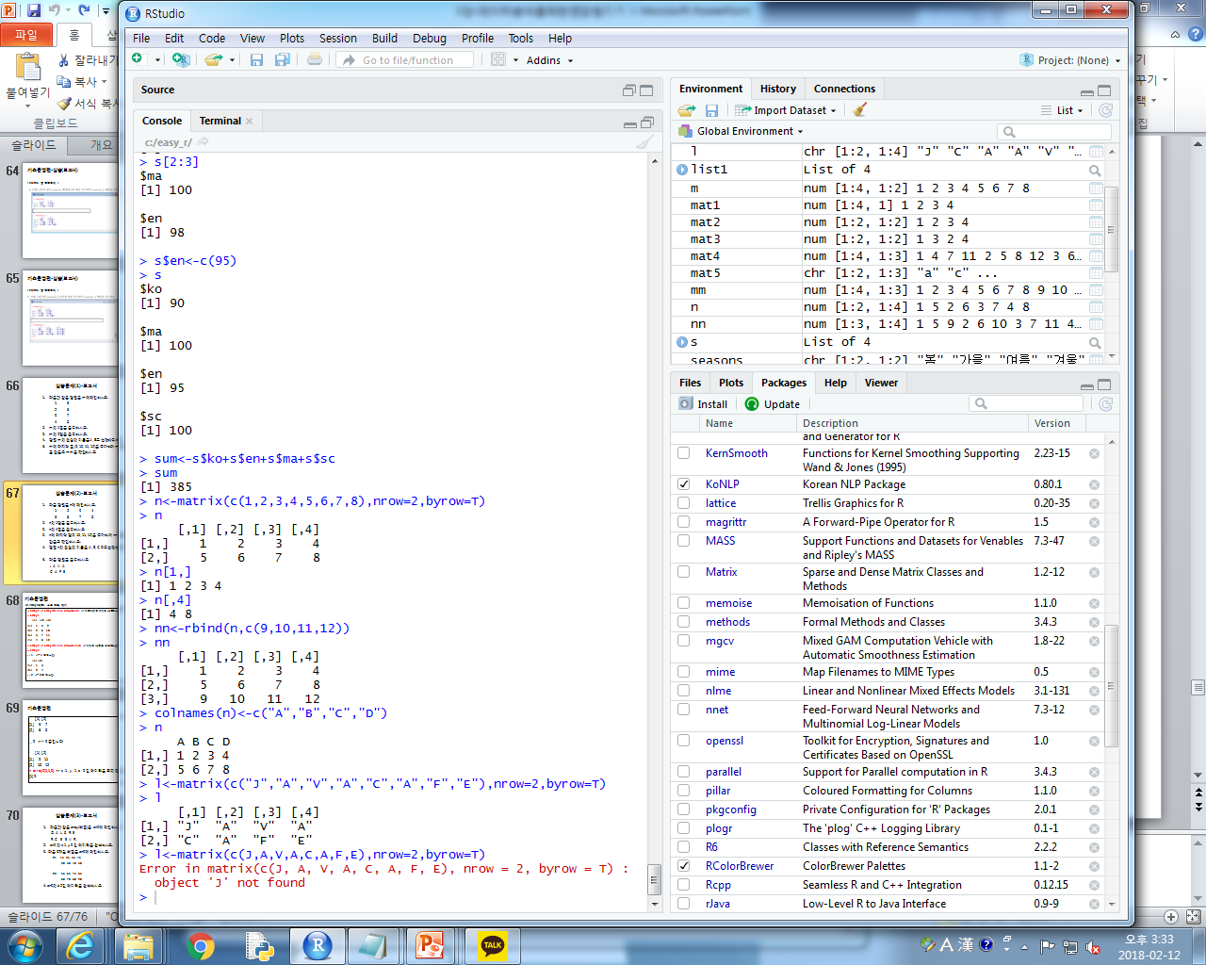
실습문제2-n 행렬
mm<-cbind(m,c(9,10,11,12))
mm
n<-matrix(c(1,2,3,4,5,6,7,8),nrow=2,byrow=T)
n
n[1,]
n[,4]

Slide 16
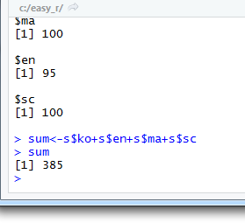
리스트 문제 SUM
s<-list(ko=90, ma=100, en=98)
s
s$sc<-100
s
s$en
s[2:3]
s$en<-c(95)
s
sum<-s$ko+s$en+s$ma+s$sc
sum

Slide 17
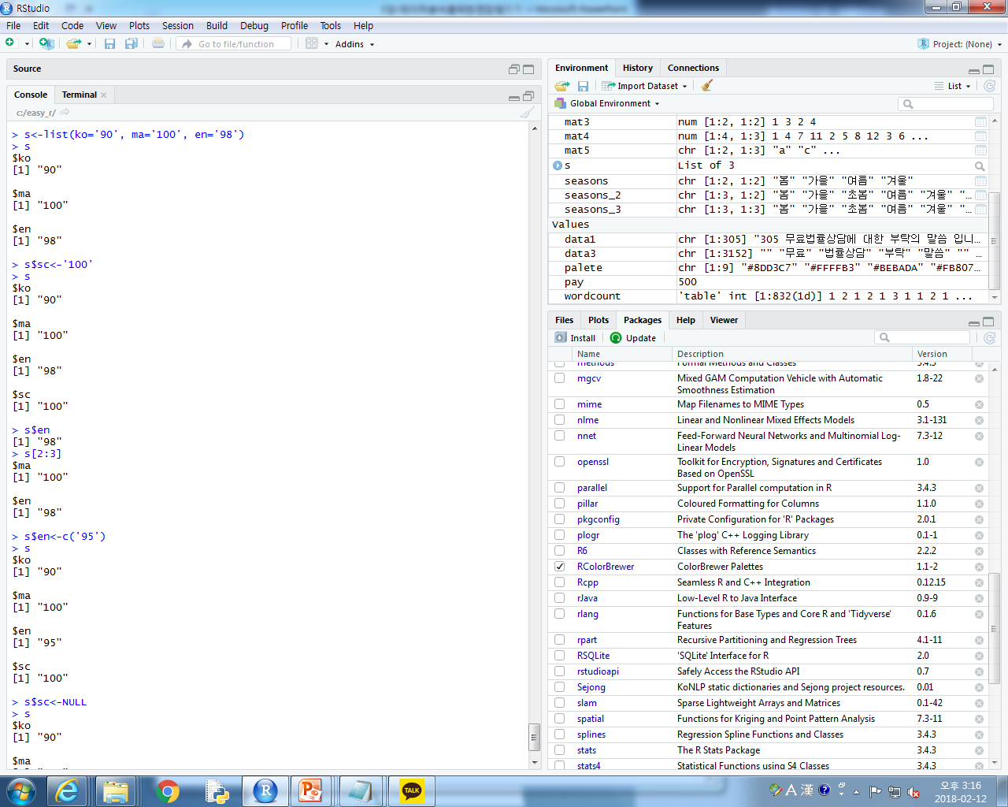
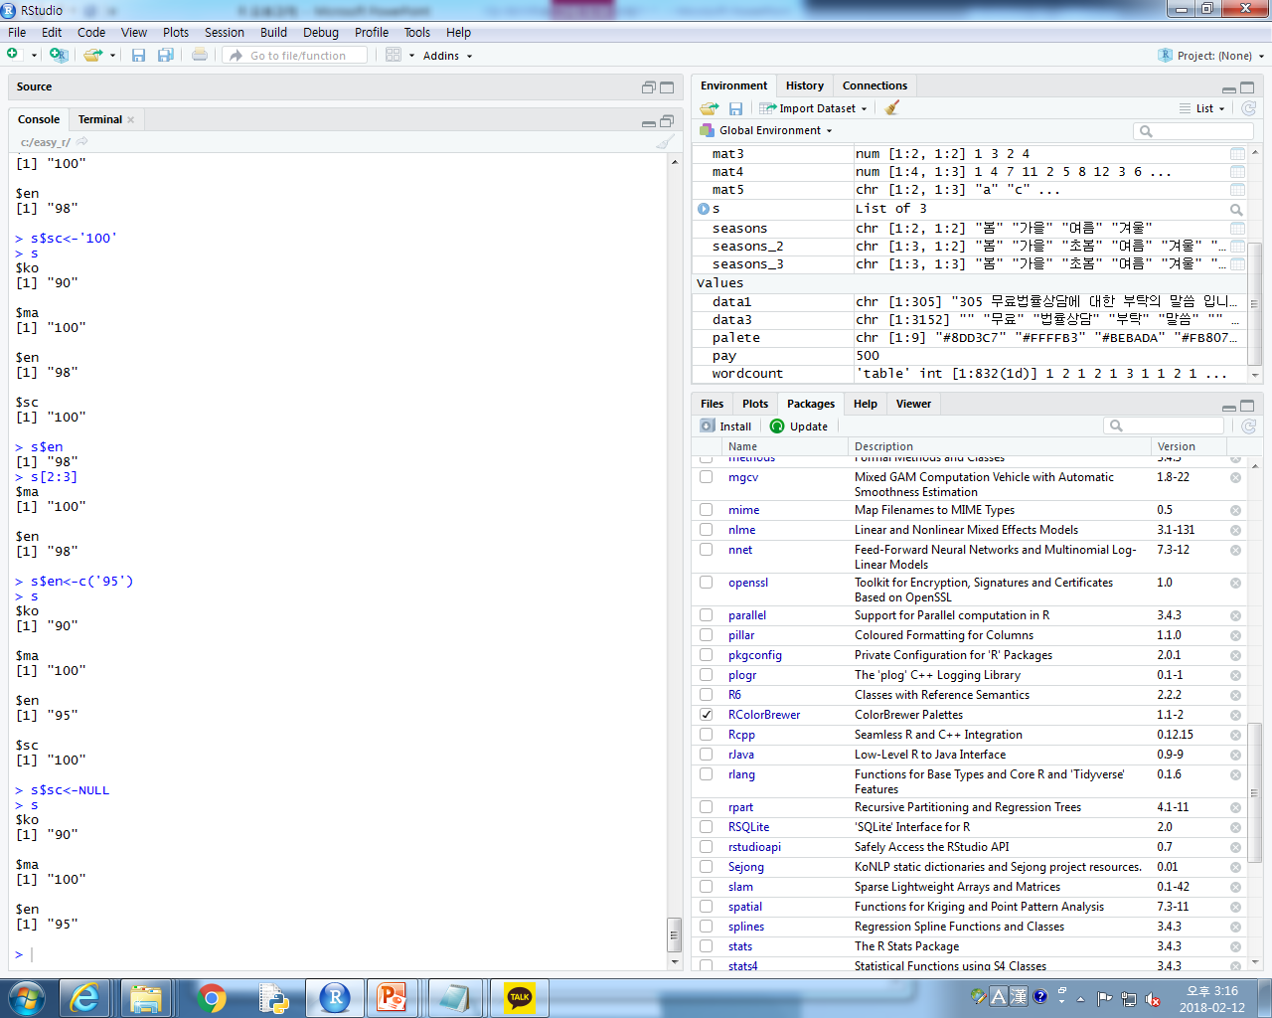
리스트
s<-list(ko='90', ma='100', en='98')
s
s$sc<-'100'
s
s$en
s[2:3]
s$en<-c('95')
s
s$sc<-NULL
s

Slide 18
setwd("c:\\easy_r")
install.packages("KoNLP")
install.packages("wordcloud")
install.packages("stringr")
library(KoNLP)
library(wordcloud)
library(stringr)
useSejongDic()
mergeUserDic(data.frame(readLines("제주도여행지.txt"),"ncn"))
txt<-readLines("jeju.txt")
place<-sapply(txt,extractNoun,USE.NAMES = F)
place
head(unlist(place),30)
cdata<-unlist(place)
place<-str_replace_all(cdata,"[^[:alpha:]]","")
place<-gsub(" ","",place)
txt<-readLines("제주도여행코스gsub.txt")
txt

Slide 19
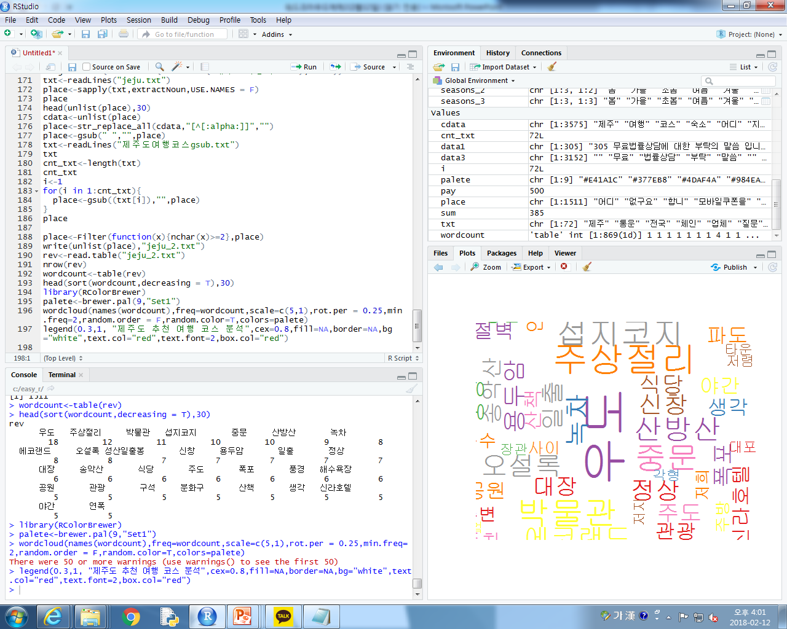
Notes:
setwd("c:\\easy_r")
install.packages("KoNLP")
install.packages("wordcloud")
install.packages("stringr")
library(KoNLP)
library(wordcloud)
library(stringr)
useSejongDic()
mergeUserDic(data.frame(readLines("제주도여행지.txt"),"ncn"))
txt<-readLines("jeju.txt")
place<-sapply(txt,extractNoun,USE.NAMES = F)
place
head(unlist(place),30)
cdata<-unlist(place)
place<-str_replace_all(cdata,"[^[:alpha:]]","")
place<-gsub(" ","",place)
txt<-readLines("제주도여행코스gsub.txt")
txt
cnt_txt<-length(txt)
cnt_txt
i<-1
for(i in 1:cnt_txt){
place<-gsub((txt[i]),"",place)
}
place
place<-Filter(function(x){nchar(x)>=2},place)
write(unlist(place),"jeju_2.txt")
rev<-read.table("jeju_2.txt")
nrow(rev)
wordcount<-table(rev)
head(sort(wordcount,decreasing = T),30)
library(RColorBrewer)
palete<-brewer.pal(9,"Set1")
wordcloud(names(wordcount),freq=wordcount,scale=c(5,1),rot.per = 0.25,min.freq=2,random.order = F,random.color=T,colors=palete)
legend(0.3,1, "제주도 추천 여행 코스 분석",cex=0.8,fill=NA,border=NA,bg="white",text.col="red",text.font=2,box.col="red")

